Slide 1



Dhahran E-Shipping System SWE445: Secure Software Project Presentation
Doctor: Mahmood Niazi
Group 4
Notes:
Hi everyone my name is osama and I am going to talk about our project about Dhahran E-Shipping System.

Slide 2

Outlines
Use Case Model
Database
User Interface
References
Notes:
These are the outlines of our presentation.

Slide 3
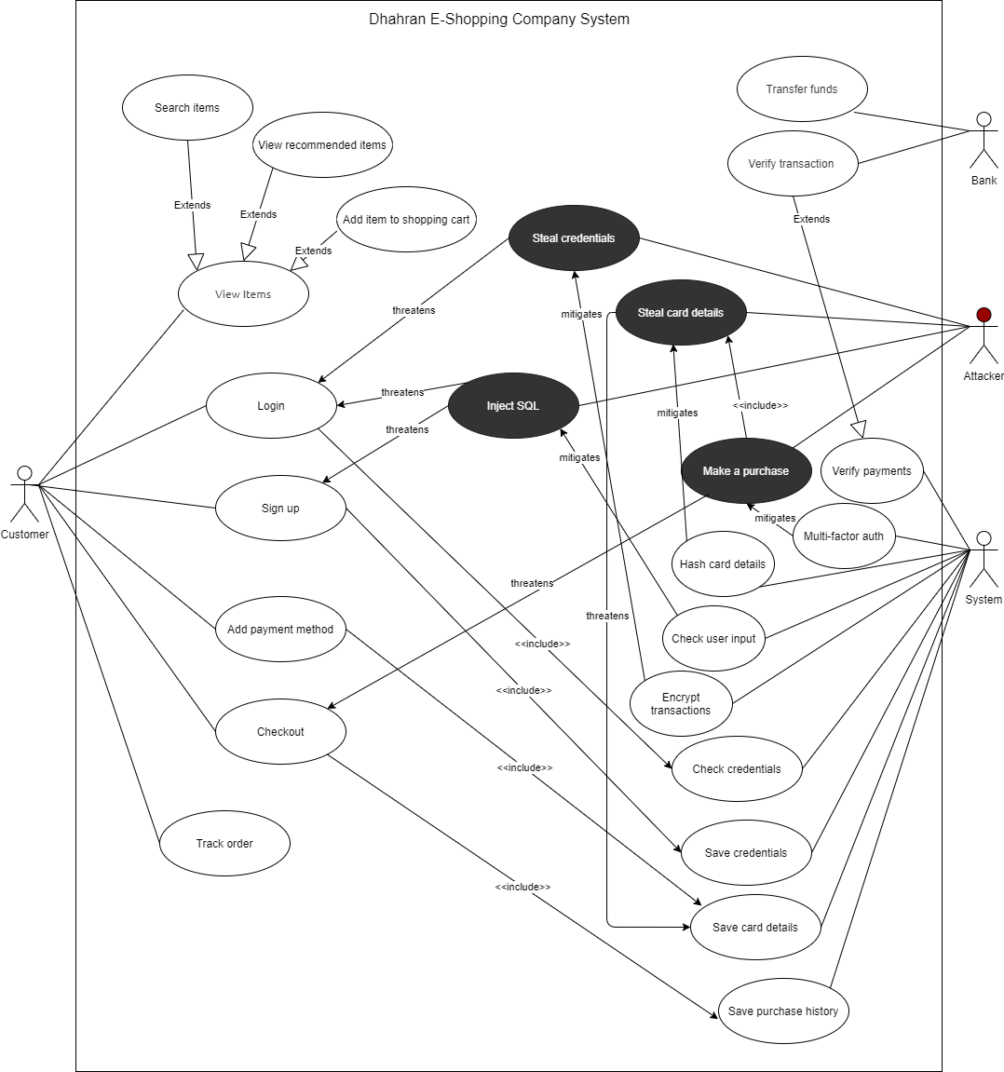
Use Case Model
Actors
Customer
System
Bank
Attacker
Notes:
First Let talk about the use case model.
In our project make 3 actors which are
Customer
System
Bank
Attacker
Each Actor has specific uses for example

Slide 4

Database
Conceptual Design
Logical Design
Entity Relation Diagram
Notes:
For the Database it disturuted in 3 parts
Conceptual Design
Logical Design
Entity Relation Diagram

Slide 5
Database Conceptual Design
Customer | Items | Order | Card | Auth Code
C_ID (PK) Name Phone Email Password | I_ID (PK) Name Price | O_ID (PK) Payment Method Total Date & Time C_ID (FK) I_ID (FK) | Card number(PK) Expiration _date Secret_number Holder_name C_ID (FK) | A_ID(PK) Code TTL C_ID (FK) I_ID (FK)
Notes:
For our data base we have 5 Relations types and these are
Customer
Items
Order
Card
Auth Code
And each type has these Attriubutes

Slide 6
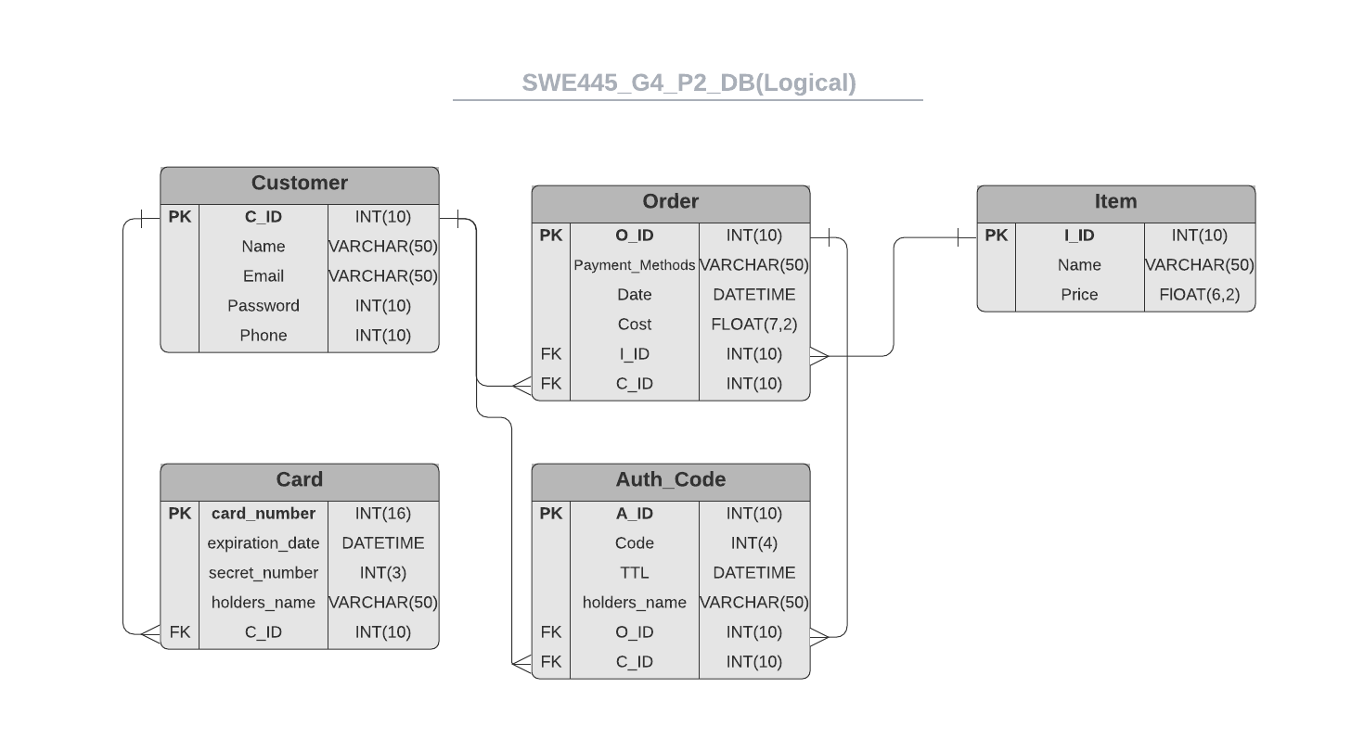
Database Logical Design
Notes:
Link: https://lucid.app/lucidchart/invitations/accept/b8695637-08f7-4b5a-93da-efc60bd71d65?viewport_loc=239%2C-150%2C2151%2C941%2C0_0

Slide 7
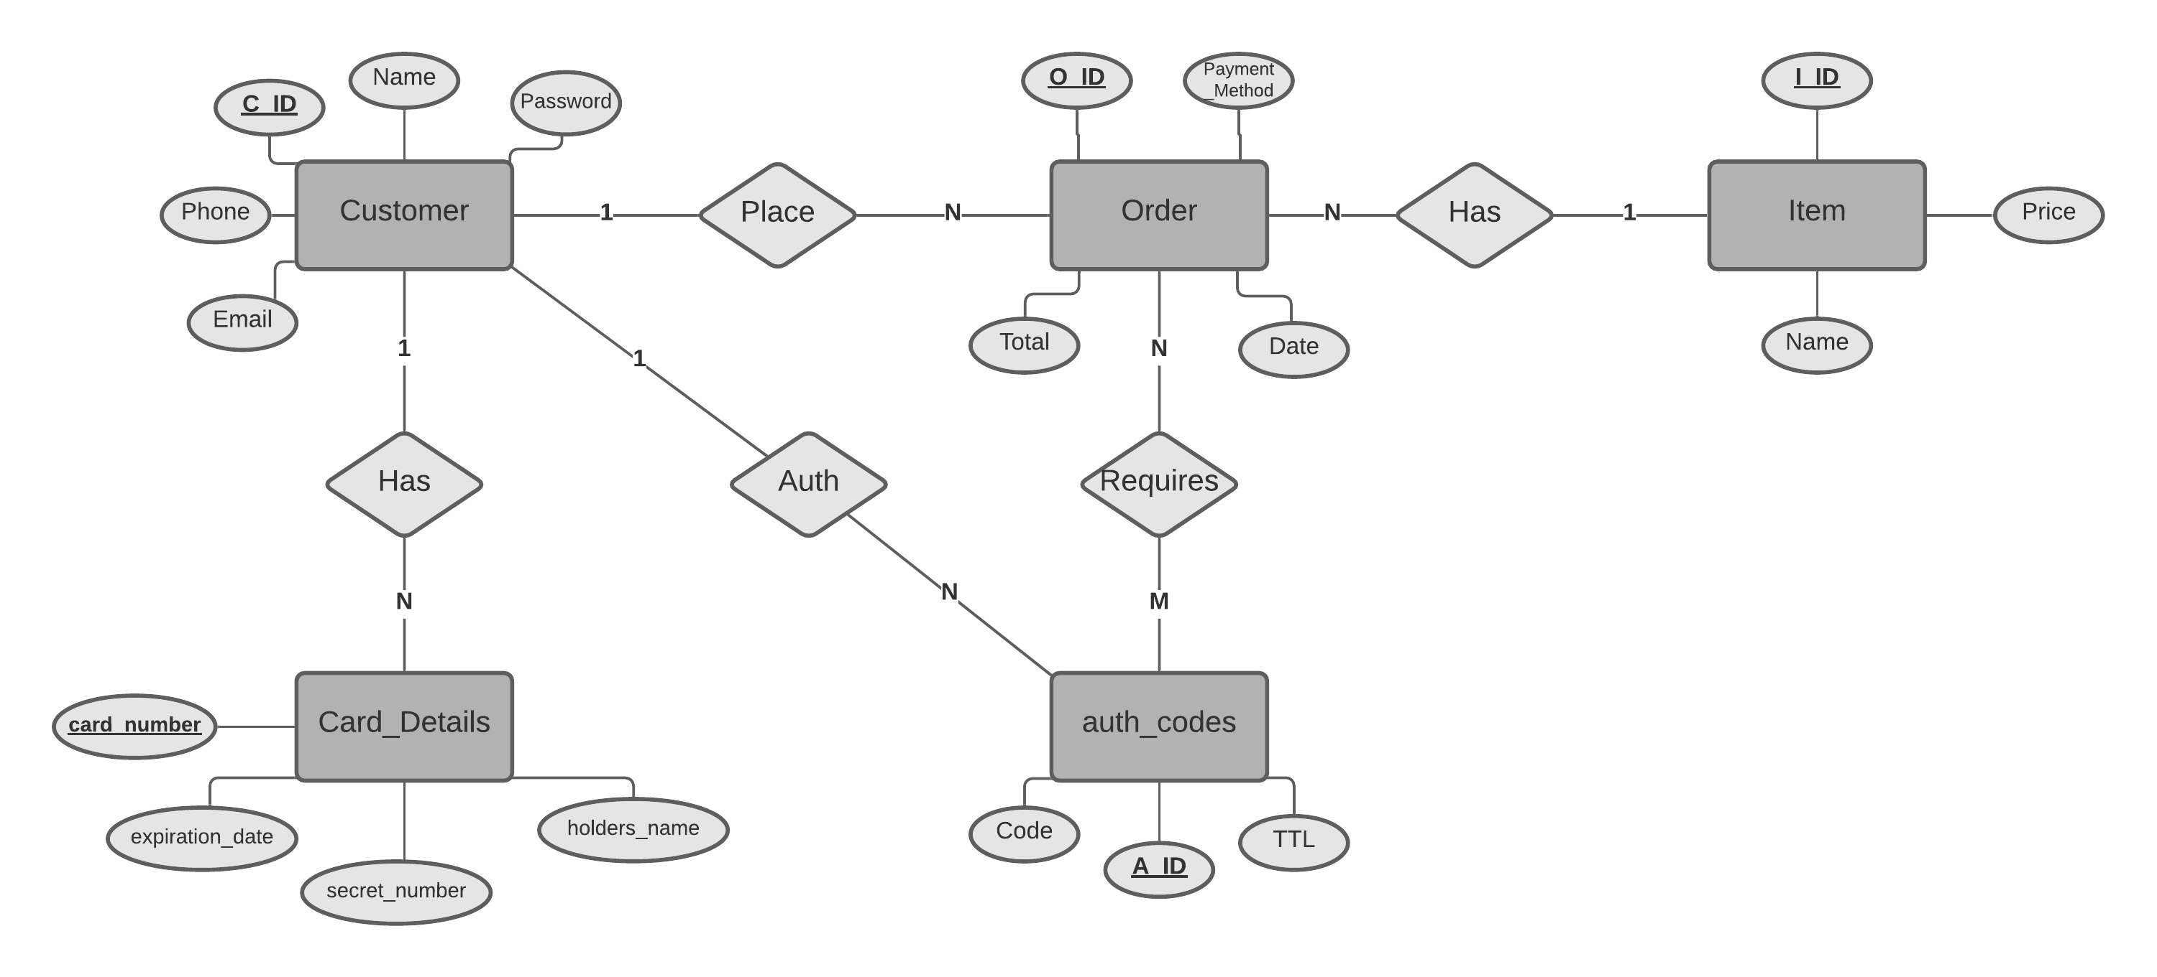
Database Entity Relation Diagram
Notes:
Link: https://lucid.app/lucidchart/invitations/accept/61b088c3-c1a6-4295-a798-1ec68cddc8c1?viewport_loc=-69%2C13%2C1707%2C823%2C0_0

Slide 8
User Interface Design Demo
Pages & Mitigations
Sign-in & Sign-up page – Check User Input
Check Verification Code page
Card Details Page - Has

Slide 9
References
Link To MS Teams Files
https://teams.microsoft.com/_#/school/files/General?threadId=19%3A7eb7d2c013064884bb618f2badd4c743%40thread.tacv2&ctx=channel&context=General&rootfolder=%252Fsites%252FSWE-455-Group4%252FShared%2520Documents%252FGeneral

Slide 10
Thank you Any Questions?

